Slide 1
Alliances & Industry Standards
Curriculum Department Facilitated Virtual Learning Journey (FVLJ):
Definition and Examples
April 2013
MOVING AS ONE, WINNING AS MANY

Slide 2
FVLJ Definition
2

Slide 3
FVLJ Notes
An FVLJ is a virtual learning journey with an emphasis on a strong self-study component
Global program for broad reach and diversified experience
Supported by Our University and regional resources
For 2013 and going forward, funding is proposed to be part of the University fee. Courses would be free (other than the support by regional resources)
Business cases would need to be documented and approved for each program (e.g., PMI, ITIL, etc.)
Produced an FVLJ model using PMI as a pilot (slide 4) and implemented a global program for ITIL Foundation (slide 5)
3

Slide 4
Definition: Facilitated Virtual Learning Journey (FVLJ)
Facilitated Virtual Learning Journey (FVLJ) Definition
A learning journey that combines synchronous and asynchronous virtual learning interventions with a strong component of self-directed learning. The learner is actively guided by a facilitator and supported by SMEs throughout the journey to ensure the learning objectives are successfully met.
The FVLJ is structured with a defined start and end that includes a knowledge assessment and has intermediate checkpoints to sustain momentum with the learners.
It is offered as a global program in order to create an international experience and reach a maximum number of participants across the target population
Consisting of
Facilitated virtual session to kick-off the learning journey
Individual study interspersed by facilitated virtual sessions used as “checkpoints” and to provide SME guidance
Participant-driven “on the job training” (OJT) as a means of applying recently acquired knowledge and skills
Facilitated virtual session to close the learning journey experience and prepare participants for certification
Leveraging
Existing content (eLearning, videos, book extracts, documents, assignments, Capgemini proprietary content)
Video and audio conferencing technologies
Social collaboration tools such as Yammer
Supported by
Our University with respect to Operations and Virtual University Qualified Facilitators (VUQF) processes
Regions with respect to Communications, Promotion, Impact Measurement, and providing access to SMEs/VUQFs
Both Our University and Regions for Content Design
4

Slide 5
An FVLJ is a combination of virtual learning interventions that addresses the learning objectives of a learner between two points.
Pre-Assessment
Learning Interventions
(spanning months)
Post-Assessment
Group (Required)
Kick-off
Virtual Sessions
Individual (Required)
eLearning
Individual Assignments
Individual (Recommended)
OJT
Virtual Teamwork (Group Assignments)
Self-study
Virtual Coaching
Closing Session
Participant Qualification
Acceptance into FVLJ
Assessment or Exam
Certification (if offered)
Technologies to support FVLJ learning interventions include:
Live Meeting
Adobe Connect
Yammer
5

Slide 6
FVLJ Example 1: PMP Certification Preparation
6

Slide 7
FVLJ for PMP Certification
Active project manager or team lead
Application for EM Certification in process
Eligible for PMP Certification
Able to apply PMBOK principles
An active contributor to the EM Community
PMP Certified
10 Weeks
(with Kick-off in advance to explain PMP application process)
Week 0 |  | Week 1 | Week 2 | Week 3 | Week 4 | Week 5 | Week 6 | Week 7 | Week 8 | Week 9 | Week 10
PMP Application Accepted
PMBOK 1 – 3
PMBOK 4 – 5
PMBOK 6 – 7
PMBOK 5 - 7
PMBOK 4
PMBOK 9 & 10
PMBOK 12
PMBOK 8
PMBOK 11
Code of Ethics
Indiv. Pre-work
SA
SA
SA
SA
SA
SA
SA
SA
SA
Sample Test
(1 hour)
PMP Exam
PMP FVLJ Kick-off (1 hr)
Intro, Basics
Init., Scope Plan
Sked, Cost Plan
Scope, Sked, Cost Cntrl & Mgmt
Integ Mgmt & Close
HR Mgmt & Comms Mgmt
Procurement Mgmt
Quality Mgmt
Risk Mgmt
Ethics, Summary, Close
Group Required
WBLs 1 – 3
WBLs 4, 7, 8
WBLs 10 – 13
WBLs 6, 9, 12, 14
WBLs 4 – 6
WBLs 17 – 20
WBLs 25, 26
WBLs 15, 16
WBLs 21 – 24
WBLs 27, 28
Indiv. Suggested
OJT
Self Assessments – approximately 20 minutes each
Virtual Classrooms – 90 minutes each
Reading Assignment
Self Assessment
Virtual Classroom
eLearning
On the Job Training
Cert

Slide 8
FVLJ for PMP Certification – Structure (Updated per Business Review)
Kick-off in Week 0 is open to anyone. The program is 10 weeks with an informational kick-off prior to the first virtual session to explain the PMP application process
Weekly virtual sessions are approximately 90 minutes each
For each ensuing virtual session, the participant is required to complete assigned pre-work. This includes reading of PMBOK chapters which have been mapped to the upcoming session topic and completing a self-assessment to gauge understanding of chapter(s) content
Online PMP courses can be used as supplemental training for topics for which more training is needed. These courses can be taken either before or after the virtual session on the topic
Virtual sessions are to enhance the knowledge obtained through the required pre-work (reading of PMBOK chapters) by summarizing the content and addressing participant questions
Virtual sessions leverage existing Capgemini training content for a PMP program currently delivered in Germany, which has been accredited by PMI
8

Slide 9
Hightlights of Existing PMI FVLJ Content
Existing Capgemini PMI Training
Background
More than 3 years of in-house Experience is built into the material and the course
PMI REP (Registered Education Provider) Status guarantees quality as well as necessary contact hours for the exam and PDUs for the trainers
In-house developed course material focuses not only on PMI exam, but links to our actual day-to-day business needs and to the “real-world”
100% pass rate so far with combination of classroom trainings and webinars
Yammer community to support participants and team-building
Includes
Mapping of content to PMBOK
Linked to Capgemini real-world activities and approach
Games & Energizers during classroom trainings
Sample of PMI-like Exam Questions as Part of every Webinar
Existing Online PMI Training
Background
Provided by SkillSoft, PMI REP
Existing learning map of WBLs
Previous Capgemini programs leveraging this content achieved a +95% pass rate
Includes
Web-based training courses aligned to PMBOK
Quizzes on content embedded in each training course
Available study guides and sample test
Mentoring (including live chat) available through Project Management Knowledge Center
Sample tests that can be taken in Study Mode (provides feedback after each question) or Certification Mode (score provided at the end)

Slide 10
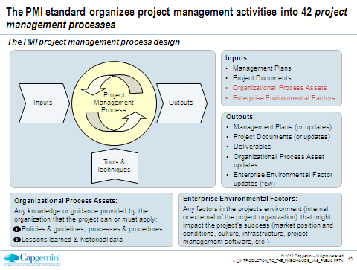
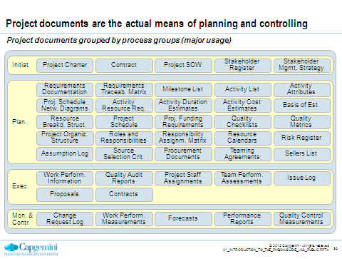
Existing Capgemini PMI Training – Sample Content

Slide 11
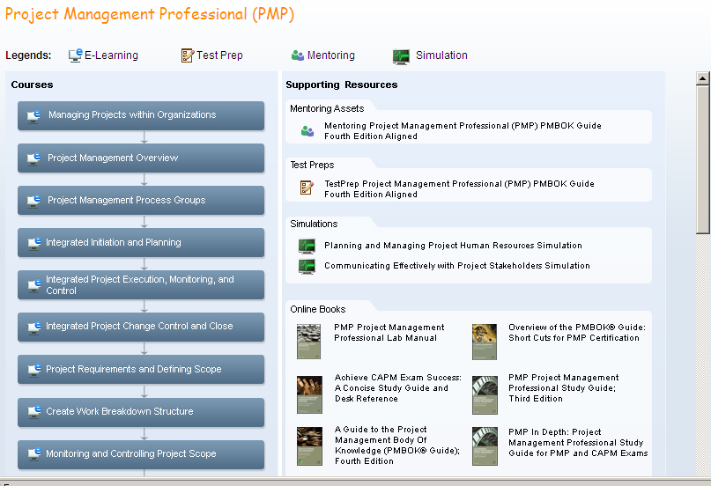
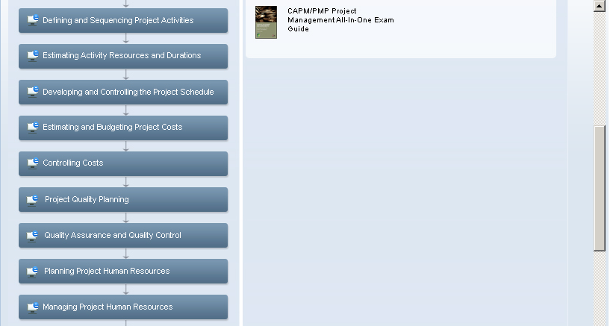
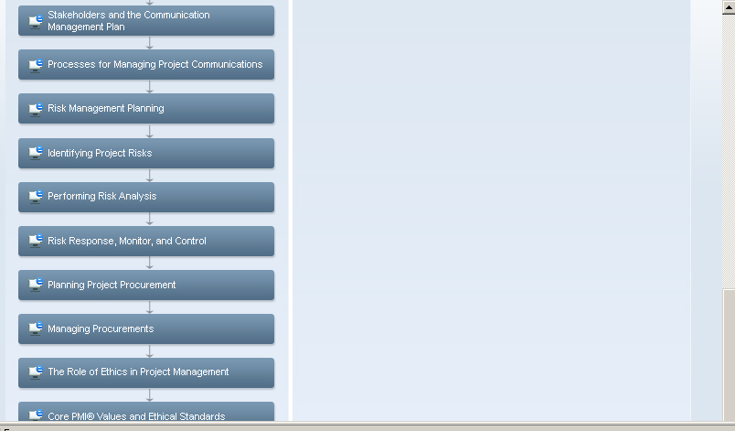
Existing Online PMI Training – Learning Map
28 courses covering the PMBOK concepts and principles
Additional books and guides
Mentoring – chat live online
Test Prep – offers 40 sample test questions, which can be taken multiple times with different questions each time a person takes it. The exam can be taken in Study Mode (provides feedback after each question) or Certification Mode (score provided at the end)

Slide 12
FVLJ Example 2: ITIL Foundation certification training
12

Slide 13
FVLJ for ITIL Foundation Certification Prep
Open to anyone
Able to apply ITIL ITSM principles
ITIL Foundation Certified
7 Weeks
Week 1 | Week 2 | Week 3 | Week 4 | Week 5 | Week 6 | Week 7
WBLs 1 – 3
WBLs 4 – 5
WBL 6
WBLs 7 – 8
WBL 9
TestPrep
Indiv. Pre-work
ITIL Foundation Exam
Kick-off & ITIL Overview
Service Design Fundatmentls & Proceses
Service Transition Processes & Policies
Intro to Service Operations
Service Operations Processes
Continual Service Implemenatio Fundamentals
Study Review Session
Group Required
Indiv. Suggested
Reading
OJT
Self-paced study – 2 to 4 hours per week
Virtual Classrooms – 1 hour each
Reading Assignment
Self Assessment
Virtual Classroom
eLearning
On the Job Training
Cert

Slide 14
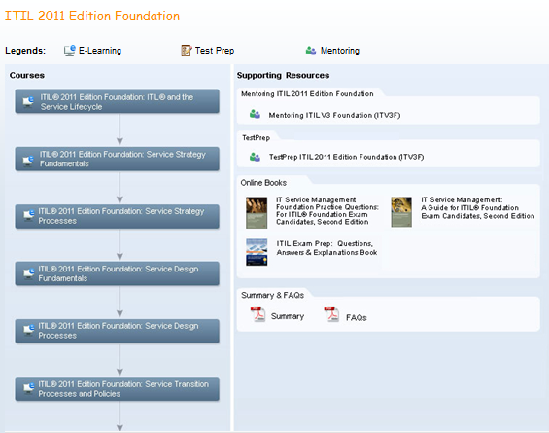
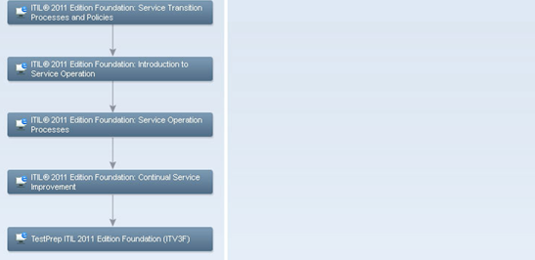
Existing Online ITIL Foundation Training – Learning Map
9 courses covering the ITIL Foundation concepts and principles
Additional books and guides
Mentoring – chat live online
Test Prep – offers sample test questions, which can be taken multiple times with different questions each time a person takes it. The exam can be taken in Study Mode (provides feedback after each question) or Certification Mode (score provided at the end)

Slide 15
Existing Capgemini ITIL Foundation Training– Sample Content

Slide 16
Next Steps
16

Slide 17
Typical Deployment Activities
Area | Sub-topics
Governance & Budget | Identify course owner, University NGL Lab validation of learning journey, Pilot RDW funding, Business case with high level draft of structure
Design & Build | Program schedule, Updates to virtual session content, Creation of assignments, Definition and creation of assessments
Logistics | Facilitators and SMEs, Registration, Video and audio technology, Collaborative platform
Marketing and Communications | Communications Plan, Distribution of communications, Creation and distribution of welcome emails
Delivery | Facilitator and SME Prep, Delivery of sessions
Pilot Review | Gather and analyze program assessments from participants, Gather and analyze knowledge application assessments, Request and review impact analysis

